Slide 1
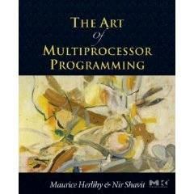

Introduction to Multiprocessor Synchronization
Maurice Herlihy
TexPoint fonts used in EMF.
Read the TexPoint manual before you delete this box.: AAAA
Notes:
1

Slide 2
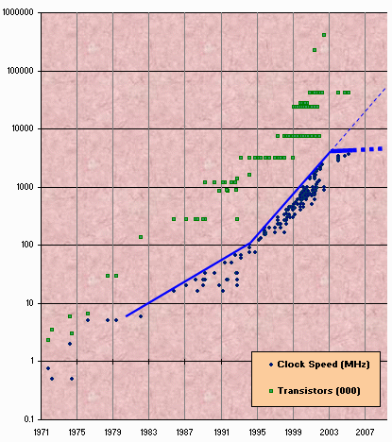
Moore's Law
Transistor count still rising
Clock speed flattening sharply
2
Notes:
2
Most of you have probably heard of Moore's law, which states that the number of transistors on a chip tends to double about every two years. Moore's law has been the engine of growth for our field, and the reason you can buy a laptop for a few thousand dollars that would have cost millions a decade earlier. The green dots on this graph show that transistor sizes continue to shrink, but the blue dots show that clock speeds have stop improving.

Slide 3
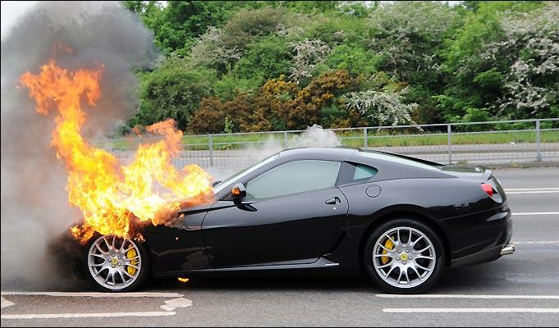
Moore's Law (in practice)

Slide 4
Once roamed the Earth: the Uniprocesor
cpu
memory
4
Notes:
4
Traditionally, we have had inexpensive single processor with an associated memory on a chip, which we call a uniprocessor.

Slide 5
Endangered:
The Shared Memory Multiprocessor
(SMP)
cache
cache
cache
Bus
Bus
shared memory
5
Notes:
5
And we had expensive multiprocessor chips in the enterprise, that is, in server farms, high performance computing centers and so on. The
Shared memory multiprocessor (SMP) consists of multiple CPUs connected by a bus or interconnect network to a shared memory.

Slide 6
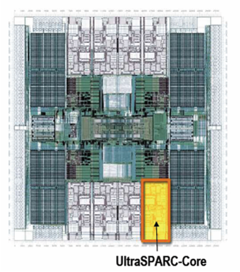
Meet he New Boss:
The Multicore Processor
(CMP)
All on the
same chip
Oracle Niagara
Chip
cache
cache
cache
Bus
Bus
shared memory
6
Notes:
6
The revolution we are going through is that the desktop is now becoming a multiprocessor also. We call this type of processor a system-on-a-chip or a multicore machine or a chip multiprocessor (CMP). The chip you see here is the Sun T2000 Niagara CMP that has 8 cores and shared cache and memory.

Slide 7
From the 2008 press…
…Intel has announced a press conference in San Francisco on November 17th, where it will officially launch the Core i7 Nehalem processor…
…Sun's next generation Enterprise T5140 and T5240 servers, based on the 3rd Generation UltraSPARC T2 Plus processor, were released two days ago…
7
Notes:
7
In 1994, Intel made a quiet announcement that was to have profound consequences for everyone who uses computers. The long-term importance of this news was only slowly appreciated. Essentially, Intel stated that they have given up trying to make the Pentium processor, their flagship product run faster. They didn't actually say why, but the word on the street is that they overheat. This is a substantial change from the way the field has worked from the very beginning.

Slide 8
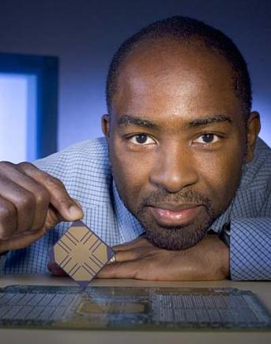
Why is Kunle Smiling?
Niagara 1
8
Notes:
Cause he doesn't have to write the software…
8

Slide 9
Why do we care?
9
Time no longer cures software bloat
  The “free ride” is over
When you double your program's path length
  You can't just wait 6 months
  Your software must somehow exploit twice as much concurrency
Notes:
9
Why do you care? Because the way you wrote software until now will disappear in the next few years. The free ride where you write software once and trust Intel, Sun, IBM, and AMD to make it faster is no longer valid.

Slide 10
Traditional Scaling Process
7x
Speedup
3.6x
1.8x
User code
Traditional
Uniprocessor
Time: Moore's law
10
Notes:
10
Recall the traditional scaling process for software: write it once, trust Intel to make the CPU faster to improve performance.

Slide 11
Ideal Multicore Scaling Process
7x
3.6x
Speedup
1.8x
User code
Multicore
Unfortunately, not so simple…
11
Notes:
11
With multicores, we will have to parallelize the code to make software faster, and we cannot do this automatically (except in a limited way on the level of individual instructions).

Slide 12
Actual Multicore Scaling Process
Speedup
2x
2.9x
1.8x
User code
Multicore
Parallelization and Synchronization
require great care…
12
Notes:
12
This is because splitting the application up to utilize the cores is not simple, and coordination among the various code parts requires care.

Slide 13
Multicore Programming:
Course Overview
Fundamentals
  Models, algorithms, impossibility
Real-World programming
  Architectures
  Techniques
13
Notes:
13
Here is our course overview. (at the end, we aim to give you a basic understanding of the issues, not to make you experts)
In this course, we will study a variety of synchronization algorithms, with an emphasis on informal reasoning about correctness.
Reasoning about multiprocessor programs is different in many ways from the more familiar style of reasoning about sequential programs.
Sequential correctness is mostly concerned with safety properties, that is, ensuing that a program transforms each before-state to the correct
after-state. Naturally, concurrent correctness is also concerned with safety, but the problem is much, much harder, because safety must be ensured despite the vast number of ways steps of concurrent threads can be be interleaved. Equally important, concurrent correctness encompasses a variety of liveness properties that have no counterparts in the sequential world.
The second part of the book concerns performance. Analyzing the performance of synchronization algorithms is also different in flavor from analyzing the performance of sequential programs. Sequential programming is based on a collection of well-established and well-understood abstractions. When you write a sequential program, you usually do not need to be aware that underneath it all, pages are being swapped from disk to memory, and smaller units of memory are being moved in and out of a hierarchy of processor caches. This complex memory hierarchy is essentially invisible, hiding behind a simple programming abstraction.
In the multiprocessor context, this abstraction breaks down,
at least from a performance perspective.
To achieve adequate performance,
the programmer must sometimes ``outwit'' the underlying memory system,
writing programs that would seem bizarre to someone unfamiliar with
multiprocessor architectures.
Someday, perhaps, concurrent architectures will provide the same degree of
efficient abstraction now provided by sequential architectures,
but in the meantime, programmers should beware.
We start then with fundamentals, trying to understand what is and is not computable before we try and write programs. This is similar to the process you have probably gone through with sequential computation of learning computability and complexity theory so that you will not try and solve unsolvable problems. There are many such computational pitfals when programming multiprocessors.

Slide 14
Sequential Computation
thread
memory
object
object
14
Notes:
14

Slide 15
Concurrent Computation
threads
memory
object
object
15
Notes:
15

Slide 16
Asynchrony
Sudden unpredictable delays
  Cache misses (short)
  Page faults (long)
  Scheduling quantum used up (really long)
16
Notes:
16

Slide 17
Model Summary
17
Multiple threads
Single shared memory
Objects live in memory
Unpredictable asynchronous delays
Notes:
17

Slide 18
Road Map
18
We are going to focus on principles first, then practice
  Start with idealized models
  Look at simplistic problems
  Emphasize correctness over pragmatism
  “Correctness may be theoretical, but incorrectness has practical impact”
Notes:
18
We want to understand what we can and cannot compute before we try and write code. In fact, as we will see there are problems that are Turing computable but not asynchronously computable.

Slide 19
Concurrency Jargon
19
Hardware
  Processors
Software
  Threads, processes
Sometimes OK to confuse them, sometimes not.
Notes:
19
We will use the terms above, even though there are also terms like strands, CPUs, chips etc also…

Slide 20
Parallel Primality Testing
20
Challenge
  Print primes from 1 to 10¹⁰
Given
  Ten-processor multiprocessor
  One thread per processor
Goal
  Get ten-fold speedup (or close)
Notes:
20
We want to look at the problem of printing the primes from 1 to 10^10 in some arbitrary order.

Slide 21
Load Balancing
1
10⁹
2·10⁹
…
10¹⁰
P₀
P₁
…
P₉
Split the work evenly
Each thread tests range of 10⁹
21
Notes:
21
Split the range ahead of time

Slide 22
Procedure for Thread i
void primePrint {
int i = ThreadID.get(); // IDs in {0..9}
for (j = i*10⁹+1, j<(i+1)*10⁹; j++) {
if (isPrime(j))
print(j);
}
}
22
Notes:
22
Code matches code in Chapter 1 of book.

Slide 23
Issues
23
Higher ranges have fewer primes
Yet larger numbers harder to test
Thread workloads
  Uneven
  Hard to predict
Notes:
23
You can mention that the use of prime() is a bit artificial since it makes sense to use earlier numbers detected as prime in testing whether a later number is prime.
Jean-Paul Rigault of the University of Nice Sophia Antipolis in France tells us that there are
Overall 454 millions Primes between 1 and 10¹⁰, 51 million of them between 0x10⁹ and 1x10⁹ and 43 million of them between 9x10⁹ and 10x10⁹. The primes seem rather uniformly distributed in the given range, although there are indeed fewer between 9x10⁹ and 10¹⁰ than between 1 and 10⁹ (about 20% less).
He obtained these numbers using a Python program implementing Legendre's approximation for pi(n), the number of primes less than n: pi(n) = n/(log n - 1).

Slide 24
Issues
rejected
24
Higher ranges have fewer primes
Yet larger numbers harder to test
Thread workloads
  Uneven
  Hard to predict
Need dynamic load balancing
Notes:
24
You can mention that the use of prime() is a bit artificial since it makes sense to use earlier numbers detected as prime in testing whether a later number is prime.
Jean-Paul Rigault of the University of Nice Sophia Antipolis in France tells us that there are
Overall 454 millions Primes between 1 and 10¹⁰, 51 million of them between 0x10⁹ and 1x10⁹ and 43 million of them between 9x10⁹ and 10x10⁹. The primes seem rather uniformly distributed in the given range, although there are indeed fewer between 9x10⁹ and 10¹⁰ than between 1 and 10⁹ (about 20% less).
He obtained these numbers using a Python program implementing Legendre's approximation for pi(n), the number of primes less than n: pi(n) = n/(log n - 1).

Slide 25
Shared Counter
19
each thread takes a number
18
17
25
Notes:
25

Slide 26
Procedure for Thread i
int counter = new Counter(1);
void primePrint {
long j = 0;
while (j < 10¹⁰) {
j = counter.getAndIncrement();
if (isPrime(j))
print(j);
}
}
26
Notes:
26

Slide 27
Procedure for Thread i
Counter counter = new Counter(1);
void primePrint {
long j = 0;
while (j < 10¹⁰) {
j = counter.getAndIncrement();
if (isPrime(j))
print(j);
}
}
Shared counter
object
27
Notes:
27

Slide 28
Where Things Reside
void primePrint {
int i = ThreadID.get(); // IDs in {0..9}
for (j = i*10⁹+1, j<(i+1)*10⁹; j++) {
if (isPrime(j))
print(j);
}
}
Local
variables
code
cache
cache
cache
Bus
Bus
shared
memory
1
shared counter
28
Notes:
28
Need this slide since some students do not understand where the counter resides, where the shared variables reside, and where the code resides etc. This is our opportunity to explain.

Slide 29
Procedure for Thread i
Counter counter = new Counter(1);
void primePrint {
long j = 0;
while (j < 10¹⁰) {
j = counter.getAndIncrement();
if (isPrime(j))
print(j);
}
}
Stop when every value taken
29
Notes:
29

Slide 30
Procedure for Thread i
Counter counter = new Counter(1);
void primePrint {
long j = 0;
while (j < 10¹⁰) {
j = counter.getAndIncrement();
if (isPrime(j))
print(j);
}
}
Increment & return each new value
30
Notes:
30

Slide 31
Counter Implementation
public class Counter {
private long value;
public long getAndIncrement() {
return value++;
}
}
31
Notes:
31

Slide 32
Counter Implementation
public class Counter {
private long value;
public long getAndIncrement() {
return value++;
}
}
OK for single thread,
not for concurrent threads
32
Notes:
32

Slide 33
What It Means
public class Counter {
private long value;
public long getAndIncrement() {
return value++;
}
}
33
Notes:
33

Slide 34
What It Means
public class Counter {
private long value;
public long getAndIncrement() {
return value++;
}
}
temp = value;
value = temp + 1;
return temp;
34
Notes:
34

Slide 35
Not so good…
Value… 1
2
3
2
read
1
write
2
read
2
write
3
read
1
write
2
time
35
Notes:
35
Time goes from left to right. The Blue thread might read 1 from \fValue{}, but before it sets \fValue{} to 2, the Red thread would go through the increment loop several times, reading 1 and setting to 2, reading 2 and setting to 3. When the Blue thread finally completes its operation and sets \fValue{} to 2, it will actually be setting the counter back from 3 to 2.

Slide 36
Is this problem inherent?
!!
!!
write
read
read
write
If we could only glue reads and writes together…
36
Notes:
36
Is this phenomena inherent or is there a better implementation we are missing? To understand why such bad interleavings can always happen, consider the following situation that all of us run into every once in a while. You are walking down the street, and suddenly someone is coming straight at you. You move to the right, and they move to the right, so you move to the left, and they happen to do the same, now you try and make a final break to either left or right, many times you manage not to bump, but sometimes you do. Are these collisions avoidable? Can we think of a protocol to follow in order to prevent people from ever colliding?
The answer is NO! One might think that you can agree to always move to the right, to which you can answer ``but what if the other person is British?'' Alternately, think of Atlantis and Mir flying one towards the other in space, where the is no predefined ``right side.''} It can be mathematically shown
that there is always a sequence of moves that will result in people
bumping (this is the famous result of Fischer, Lynch, and Paterson we will
Study later in the course).
The problem arises from the fact that ``looking'' at the other person
and ``moving'' aside to avoid him are two separate operations. If one
could ``look-and-jump'' instantaneously the problem could be avoided.
In the same way that people compete for the right to pass, computers
compete to gain access to shared locations in memory. In the case of
our {\tt shared-counter}, processors are in a competition where the
winner gets the lower counter value and the looser gets the higher
one. The moral of the ``people in the street'' example is that we need
to ``glue together'' the {\tt get} and {\tt increment} operations to
get an ``instantaneous'' {\tt get-and-increment}. This operation
would execute the {\tt get} and the {\tt increment} instructions
like one indivisible operation with no other operation taking place
between the start of the {\tt get} and the end of the {\tt
increment}. If we have such an operation then the following is a
correct and efficient solution to the prime printing problem.

Slide 37
Challenge
public class Counter {
private long value;
public long getAndIncrement() {
temp = value;
value = temp + 1;
return temp;
}
}
37
Notes:
37

Slide 38
Challenge
public class Counter {
private long value;
public long getAndIncrement() {
temp = value;
value = temp + 1;
return temp;
}
}
Make these steps atomic (indivisible)
38
Notes:
38

Slide 39
Hardware Solution
public class Counter {
private long value;
public long getAndIncrement() {
temp = value;
value = temp + 1;
return temp;
}
}
ReadModifyWrite()
instruction
39
Notes:
39
We will see later that modern multiprcessors provide special types of readModiftWrite() instructions to allow us to overcome the
problem at hand. But how do we solve this problem in software?

Slide 40
An Aside: Java™
public class Counter {
private long value;
public long getAndIncrement() {
synchronized {
temp = value;
value = temp + 1;
}
return temp;
}
}
40
Notes:
40

Slide 41
An Aside: Java™
public class Counter {
private long value;
public long getAndIncrement() {
synchronized {
temp = value;
value = temp + 1;
}
return temp;
}
}
Synchronized block
41
Notes:
41

Slide 42
An Aside: Java™
public class Counter {
private long value;
public long getAndIncrement() {
synchronized {
temp = value;
value = temp + 1;
}
return temp;
}
}
Mutual Exclusion
42
Notes:
42
Java provides us with a solution: mutual exclusion in software…lets try and understand how this is done

Slide 43
Mutual Exclusion, or “Alice & Bob share a pond”
A
B
43
Notes:
43
We now present a sequence of fables, illustrating some of the basic problems.
Like most authors of fables, we retell stories mostly invented by others. The following story was told by a famous
Multiprocessing pioneer, Leslie Lamport.
See story outline in the Introduction Chapter of the Book.

Slide 44
Alice has a pet
A
B
44
Notes:
44

Slide 45
Bob has a pet
A
B
45
Notes:
45

Slide 46
The Problem
A
B
The pets don't
get along
46
Notes:
46

Slide 47
Formalizing the Problem
47
Two types of formal properties in asynchronous computation:
Safety Properties
  Nothing bad happens ever
Liveness Properties
  Something good happens eventually
Notes:
47

Slide 48
Formalizing our Problem
48
Mutual Exclusion
  Both pets never in pond simultaneously
  This is a safety property
No Deadlock
  if only one wants in, it gets in
  if both want in, one gets in
  This is a liveness property
Notes:
48
Notice that we use the term deadlock and not livelock though some people would use both to describe the
Requirement. They are not the same thing. Deadlock is used to denote that Alice and Bob are stuck and no amount of retry (backoff) will help, while livelock means backoff can help. In any case both are different from “no starvation” which is the stronger requirement that means that every request always succeeds.

Slide 49
Simple Protocol
49
Idea
  Just look at the pond
Gotcha
  Not atomic
  Trees obscure the view
Notes:
49
In the following versions of the protocol, we try and show the students which solutions will not work.
Can ask students for help in the solution by showing the first part of the slide (the Idea part) and then show the
Gotcha part once they have suggested solutions. This is true for all the next set of suggested solutions.

Slide 50
Interpretation
50
Threads can't “see” what other threads are doing
Explicit communication required for coordination
Notes:
50

Slide 51
Cell Phone Protocol
51
Idea
  Bob calls Alice (or vice-versa)
Gotcha
  Bob takes shower
  Alice recharges battery
  Bob out shopping for pet food …
Notes:
51

Slide 52
Interpretation
52
Message-passing doesn't work
Recipient might not be
  Listening
  There at all
Communication must be
  Persistent (like writing)
  Not transient (like speaking)
Notes:
52

Slide 53
Can Protocol
cola
cola
53
Notes:
53

Slide 54
Bob conveys a bit
A
B
cola
54
Notes:
54

Slide 55
Bob conveys a bit
A
B
cola
55
Notes:
55

Slide 56
Can Protocol
56
Idea
  Cans on Alice's windowsill
  Strings lead to Bob's house
  Bob pulls strings, knocks over cans
Gotcha
  Cans cannot be reused
  Bob runs out of cans
Notes:
56

Slide 57
Interpretation
57
Cannot solve mutual exclusion with interrupts
  Sender sets fixed bit in receiver's space
  Receiver resets bit when ready
  Requires unbounded number of interrupt bits
Notes:
57
Notice that the point here is that it can be used as a solution but takes an unbounded number of inturrupt bits. This is not the case with the next solution…

Slide 58
Flag Protocol
A
B
58
Notes:
58
Here is a solution that does not suffer from the problems of the former ones…

Slide 59
Alice's Protocol (sort of)
A
B
59
Notes:
59

Slide 60
Bob's Protocol (sort of)
A
B
60
Notes:
60

Slide 61
Alice's Protocol
61
Raise flag
Wait until Bob's flag is down
Unleash pet
Lower flag when pet returns
Notes:
61

Slide 62
Bob's Protocol
danger!
62
Raise flag
Wait until Alice's flag is down
Unleash pet
Lower flag when pet returns
Notes:
62
Does not meet our requirement of no deadlock. Need to improve the protocol. Can ask students for help.

Slide 63
Bob's Protocol (2nd try)
63
Raise flag
While Alice's flag is up
  Lower flag
  Wait for Alice's flag to go down
  Raise flag
Unleash pet
Lower flag when pet returns
Notes:
63

Slide 64
Bob's Protocol
Bob defers to Alice
64
Raise flag
While Alice's flag is up
  Lower flag
  Wait for Alice's flag to go down
  Raise flag
Unleash pet
Lower flag when pet returns
Notes:
64

Slide 65
The Flag Principle
65
Raise the flag
Look at other's flag
Flag Principle:
  If each raises and looks, then
  Last to look must see both flags up
Notes:
65
This intuitively explains implies why at least one of them will not
enter the critical section if both are trying at the same time. Many coordination protocols use falg raising and
The flag principle to guarantee that threads notice each other.
The following proof of mutual exclusion will not be
presented in class, but we provide it just to give you some intuition
about how one reasons about concurrent programs. Lets prove that if
they follow the algorithm the dogs will never be together in the yard.
Assume by way contradiction that this is not the case. We are assuming
that both dogs are in the yard. Therefore both Alice and Bob had a
last ``looking'' action before they let their dog enter the yard. Lets
take a look at the one who finished this looking action first. When he
(she) looked, he (she) saw that the other one's flag was down. Without
loss of generality let's assume it was Bob, so he had {\tt (=
Alice-flag 'down)} as true, otherwise he couldn't have entered the
critical section. So it follows that Alice's flag was up {\em after}
Bob finished his looking action. Therefore, Alice's looking was {\em
completely after} the end of Bob's raising of his flag, so Alice must
have seen this flag up and could not have entered the critical
section, a contradiction.

Slide 66
Proof of Mutual Exclusion
66
Assume both pets in pond
  Derive a contradiction
  By reasoning backwards
Consider the last time Alice and Bob each looked before letting the pets in
Without loss of generality assume Alice was the last to look…
Notes:
66
If both look at the same time, then its OK to assume that Alice looked last. They both have different protocols but the part of the protocols that raises the flag for the last time and looks if the other's flag is raised is the same.

Slide 67
Proof
Bob last raised flag
Alice last raised her flag
Alice's last look
Bob's last look
QED
time
Alice must have seen Bob's Flag. A Contradiction
67
Notes:
67
Explanation: assume without loss of generality that Alice was the last to look in the last look each performed before they both let their animals in the pond concurrently. Then Bob's last look must have been
before Alice's last flag raising since Bob let his pet into the pond. But since Bob raised his flag before he looked, it follows that Alice must have seen Bob's flag raised, a contradiction.

Slide 68
Proof of No Deadlock
68
If only one pet wants in, it gets in.
Notes:
68

Slide 69
Proof of No Deadlock
69
If only one pet wants in, it gets in.
Deadlock requires both continually trying to get in.
Notes:
69

Slide 70
Proof of No Deadlock
QED
70
If only one pet wants in, it gets in.
Deadlock requires both continually trying to get in.
If Bob sees Alice's flag, he gives her priority (a gentleman…)
Notes:
70

Slide 71
Remarks
71
Protocol is unfair
  Bob's pet might never get in
Protocol uses waiting
  If Bob is eaten by his pet, Alice's pet might never get in
Notes:
71
The protocol is unfair. Another property of compelling interest above no-deadlock is no-starvation:
if a pet wants to enter the yard, will it eventually succeed?
Here, Alice and Bob's protocol performs poorly. Whenever Alice and
Bob conflict, Bob defers to Alice, so it is possible that Alice's
pet can use the pond over and over again, while Bob's pet becomes
increasing uncomfortable. Later on, we will see how to make
protocols prevent starvation.
Waiting is problematic in terms of performance as we will explain in more detail later in the lecture

Slide 72
Moral of Story
Mutual Exclusion cannot be solved by
  transient communication (cell phones)
  interrupts (cans)
It can be solved by
  one-bit shared variables
  that can be read or written
72
Notes:
72
During the course we will devote quite a bit of effort to understanding the tradeoffs that have to do with the use of mutual exclusion.

Slide 73
The Arbiter Problem (an aside)
Pick a point
Pick a point
73
Notes:
73
Notice that when Alice or Bob look at the otehrs flag, it might be in the process of being raised, which
Means we need to decide from what point on the flag is up or down. We essentially want to turn a continuous process of raising the flag into a discrete process in which it only has two states and we never have an intermediate “undefined” state. The same issue arises in memory. Bits of memory are in many cases electrical units called flip-flops. If a current representing a bit of either 0 or 1 is entered into a flip-flops input wires, we would like to think of the output as either 0 or 1. But this process takes time, and the current coming out of the
flip-flop is not discrete, if we measure it at different times, especially if we measure it before the output current has stabilized, we will not get a guaranteed correct behaviour. In other words, as with the flags, we might be catching it while the bit is being raised or lowered. What hardware manufacturers do is decide on a time when they believe the current on the output will be stable. However, as the lower figure shows, picking such a point is a probabilistic event, that is, if we test the gate after 5 nano-seconds, there is always a probability that it will not give us the correct corresponding output given the inputs because the gate is unstable. However, this time is chosen so that the probability is small enough that other failure probabilities (like the probability that a spec of dust will neutralize a flip-flop) are higher.

Slide 74
The Fable Continues
74
Alice and Bob fall in love & marry
Notes:
74

Slide 75
The Fable Continues
75
Alice and Bob fall in love & marry
Then they fall out of love & divorce
  She gets the pets
  He has to feed them
Notes:
75
Joke: say that with a probability of 50% they divorce.

Slide 76
The Fable Continues
76
Alice and Bob fall in love & marry
Then they fall out of love & divorce
  She gets the pets
  He has to feed them
Leading to a new coordination problem: Producer-Consumer
Notes:
76
Joke: say that with a probability of 50% they divorce.

Slide 77
Bob Puts Food in the Pond
A
77
Notes:
77

Slide 78
Alice releases her pets to Feed
mmm…
B
mmm…
78
Notes:
78

Slide 79
Producer/Consumer
79
Alice and Bob can't meet
  Each has restraining order on other
  So he puts food in the pond
  And later, she releases the pets
Avoid
  Releasing pets when there's no food
  Putting out food if uneaten food remains
Notes:
79
Many coordination problems are producer consumer problems, in fact, whenever an algorith involves the word “buffer” chances are high that we are talking about a producer consumer algorithm.

Slide 80
Producer/Consumer
80
Need a mechanism so that
  Bob lets Alice know when food has been put out
  Alice lets Bob know when to put out more food
Notes:
80

Slide 81
Surprise Solution
A
B
cola
81
Notes:
81

Slide 82
Bob puts food in Pond
A
B
cola
82
Notes:
82

Slide 83
Bob knocks over Can
A
B
cola
83
Notes:
83

Slide 84
Alice Releases Pets
yum…
A
B
B
yum…
cola
84
Notes:
84

Slide 85
Alice Resets Can when Pets are Fed
A
B
cola
85
Notes:
85

Slide 86
Pseudocode
while (true) {
while (can.isUp()){};
pet.release();
pet.recapture();
can.reset();
}
Alice's code
86
Notes:
86

Slide 87
Pseudocode
while (true) {
while (can.isUp()){};
pet.release();
pet.recapture();
can.reset();
}
Bob's code
while (true) {
while (can.isDown()){};
pond.stockWithFood();
can.knockOver();
}
Alice's code
87
Notes:
87

Slide 88
Correctness
Mutual Exclusion
  Pets and Bob never together in pond
88
Notes:
88
Mutual Exclusion: Bob and the pets are never in the yard together.

Slide 89
Correctness
Mutual Exclusion
  Pets and Bob never together in pond
No Starvation
  if Bob always willing to feed, and pets always famished, then pets eat infinitely often.
89
Notes:
89
No-Starvation: if Bob is always willing to feed, and
the pets are always famished, then the pets will eat infinitely
often.

Slide 90
Correctness
safety
Mutual Exclusion
  Pets and Bob never together in pond
No Starvation
  if Bob always willing to feed, and pets always famished, then pets eat infinitely often.
Producer/Consumer
  The pets never enter pond unless there is food, and Bob never provides food if there is unconsumed food.
liveness
safety
90
Notes:
90
Producer/Consumer:
The pets will not enter the yard unless there is food, and Bob
will never provide more food if there is unconsumed food.
Let the students guess which property is a safety property and which is a liveness property.

Slide 91
Could Also Solve Using Flags
A
B
91
Notes:
91

Slide 92
Waiting
92
Both solutions use waiting
  while(mumble){}
In some cases waiting is problematic
  If one participant is delayed
  So is everyone else
  But delays are common & unpredictable
Notes:
92
Again, waiting si problematic as one delays all causing the computation to proceed in a sequential manner.

Slide 93
The Fable drags on …
93
Bob and Alice still have issues
Notes:
93

Slide 94
The Fable drags on …
94
Bob and Alice still have issues
So they need to communicate
Notes:
94

Slide 95
The Fable drags on …
95
Bob and Alice still have issues
So they need to communicate
They agree to use billboards …
Notes:
95

Slide 96
Billboards are Large
B
D
Letter
Tiles
From Scrabble™ box
A
C
2
3
E
1
3
1
96
Notes:
96
One tile at a time.

Slide 97
Write One Letter at a Time …
W
A
S
4
1
1
H
4
B
D
A
C
2
3
E
1
3
1
97
Notes:
97

Slide 98
To post a message
W
A
S
H
T
H
E
C
A
R
4
1
1
4
1
4
1
3
1
1
whew
98
Notes:
98

Slide 99
Let's send another message
L
A
S
E
L
L
L
A
V
A
1
1
S
1
1
1
1
1
1
4
1
M
P
3
3
1
99
Notes:
99

Slide 100
Uh-Oh
S
E
L
L
T
H
E
C
A
R
1
1
1
1
1
4
1
3
1
1
L
1
OK
100
Notes:
100

Slide 101
Readers/Writers
101
Devise a protocol so that
  Writer writes one letter at a time
  Reader reads one letter at a time
  Reader sees “snapshot”
    Old message or new message
    No mixed messages
Notes:
101
This is a classical problem that captures how our machines memory really behaves. Memory consists of individual words that can be read or written one at a time, want if we read what is being written one word at a time while others are writing memory one word at a time, how can we guarantee to see correct values.

Slide 102
Readers/Writers (continued)
102
Easy with mutual exclusion
But mutual exclusion requires waiting
  One waits for the other
  Everyone executes sequentially
Remarkably
  We can solve R/W without mutual exclusion
Notes:
102
Its also easy with producer-consumer interrupt bit based solution if we have one producer and one consumer.
Using Mutex for large chunks of memory introduces performance problems. The surprising thing is that we can actually provide a “snapshot” of memory by reading memory locations one at a time, and while others are continuously writing it, all this WITHOUT mutual exclusion. Stay tuned to see how we do this.

Slide 103
Esoteric?
performance
bottleneck
103
Java container size() method
Single shared counter?
  incremented with each add() and
  decremented with each remove()
Threads wait to exclusively access counter
Notes:
103

Slide 104
Readers/Writers Solution
size
4
3
0
0
1
4
2
0
0
7
104
Each thread i has size[i] counter
  only it increments or decrements.
To get object's size, a thread reads a “snapshot” of all counters without mutex
This eliminates the bottleneck
Notes:
104

Slide 105

Why do we care About Sequential Bottlenecks?
We want as much of the code as possible to execute in parallel
A larger sequential part implies reduced performance
Amdahl's law: this relation is not linear…
Eugene Amdahl
105
Notes:
105
Mutual exclusion and waiting imply that code is essentially executed sequentially, while one is executing it others spin doing nothing useful. The larger these sequential parts, the worst our utilization of the multiple processors on our machine. Moreover, this relation is not linear: if 25% of the code is sequential, it does not mean that on a ten processor machine we will see a 25% loss of speedup…to understand the real realation, we need to understand
Amdahl's law. Gene Amdahl was a computer science pioneer.

Slide 106
Amdahl's Law
1-thread execution time
Speedup =
N-thread execution time
106
Notes:
106
This kind of analysis is very important for concurrent computation.
The formula we need is called \emph{Amdahl's Law}.
It captures the notion that the extent to
which we can speed up any complex job (not just painting)
is limited by how much of the job must be executed sequentially.
Define the \emph{speedup} $S$ of a job to be the ratio between the
time it takes one processor to complete the job (as measured by a wall clock)
versus the time it takes $n$ concurrent processors to complete the same job.
\emph{Amdahl's Law} characterizes the maximum speedup $S$ that can be achieved by $n$
processors collaborating on an application where $p$ is the fraction of
the job that can be executed in parallel.
Assume, for simplicity,
that it takes (normalized) time 1 for a single processor to complete the job.
With $n$ concurrent processors, the parallel part takes time $p/n$ and the sequential part takes time $1-p$.
Overall, the parallelized computation takes time:
$$
1 - p + \frac{p}{n}
$$
Amdahl's Law says that the speedup, that is,
the ratio between the sequential (single-processor) time and the parallel time,
is:
$$
S = \frac{1}{1 - p + \frac{p}{n}}
$$
We show this in the next set of slides

Slide 107
Amdahl's Law
Speedup =
107
Notes:
107
AVOID USING THE WORD “CODE”, P is not a fraction of the code but if the execution time of the solution algorithm. It could be that 5% of the code are executed in a loop and account for 90% of the execution time.

Slide 108
Amdahl's Law
Parallel fraction
Speedup =
108
Notes:
108
AVOID USING THE WORD “CODE”, P is not a fraction of the code but if the execution time of the solution algorithm. It could be that 5% of the code are executed in a loop and account for 90% of the execution time.

Slide 109
Amdahl's Law
Sequential fraction
Parallel fraction
Speedup =
109
Notes:
109
AVOID USING THE WORD “CODE”, P is not a fraction of the code but if the execution time of the solution algorithm. It could be that 5% of the code are executed in a loop and account for 90% of the execution time.

Slide 110
Amdahl's Law
Sequential fraction
Parallel fraction
Speedup =
Number of threads
110
Notes:
110
AVOID USING THE WORD “CODE”, P is not a fraction of the code but if the execution time of the solution algorithm. It could be that 5% of the code are executed in a loop and account for 90% of the execution time.

Slide 111
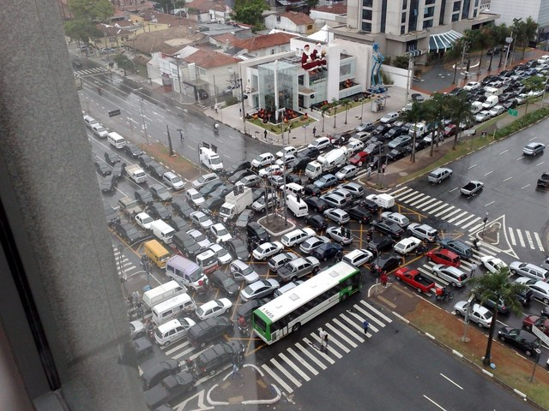
Amdahl's Law (in practice)

Slide 112
Example
Ten processors
60% concurrent, 40% sequential
How close to 10-fold speedup?
112
Notes:
112

Slide 113
Example
Ten processors
60% concurrent, 40% sequential
How close to 10-fold speedup?
Speedup = 2.17 =
113
Notes:
113
Explain to students that you work really hard and parallelize 60% of the applications execution (NOT ITS CODE, its EXECUTION)
and get little for your money

Slide 114
Example
Ten processors
80% concurrent, 20% sequential
How close to 10-fold speedup?
114
Notes:
114

Slide 115
Example
Ten processors
80% concurrent, 20% sequential
How close to 10-fold speedup?
Speedup = 3.57 =
115
Notes:
115
Even with 80% we are only 2/5 utilization, we paid for 10 CPUs and got 4…

Slide 116
Example
Ten processors
90% concurrent, 10% sequential
How close to 10-fold speedup?
116
Notes:
116
With 90% parallelized we are using only half our computing capacity…

Slide 117
Example
Ten processors
90% concurrent, 10% sequential
How close to 10-fold speedup?
Speedup = 5.26 =
117
Notes:
117
With 99% parallelized we are now utilizing 9 out of 10. What does this say to us?

Slide 118
Example
Ten processors
99% concurrent, 01% sequential
How close to 10-fold speedup?
118
Notes:
118

Slide 119
Example
Ten processors
99% concurrent, 01% sequential
How close to 10-fold speedup?
Speedup = 9.17 =
119
Notes:
119

Slide 120
Back to Real-World
Multicore Scaling
Speedup
2x
2.9x
1.8x
User code
Multicore
Not reducing sequential % of code
120
Notes:
120
This is because splitting the application up to utilize the cores is not simple, and coordination among the various code parts requires care.

Slide 121
Shared Data Structures
Coarse
Grained
Fine
Grained
25%
Shared
25%
Shared
75%
Unshared
75%
Unshared

Slide 122
Shared Data Structures
Honk!
Honk!
Honk!
Why only 2.9 speedup
Coarse
Grained
Fine
Grained
25%
Shared
25%
Shared
75%
Unshared
75%
Unshared

Slide 123
Shared Data Structures
Honk!
Honk!
Why fine-grained parallelism maters
Honk!
Coarse
Grained
Fine
Grained
25%
Shared
25%
Shared
75%
Unshared
75%
Unshared

Slide 124
This Course
Learn to minimize parallelization overhead of the fraction P that is easy
Learn how to introduce parallelism into the 1-P that are hard
124
Notes:
124

Slide 125
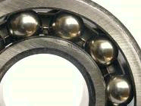
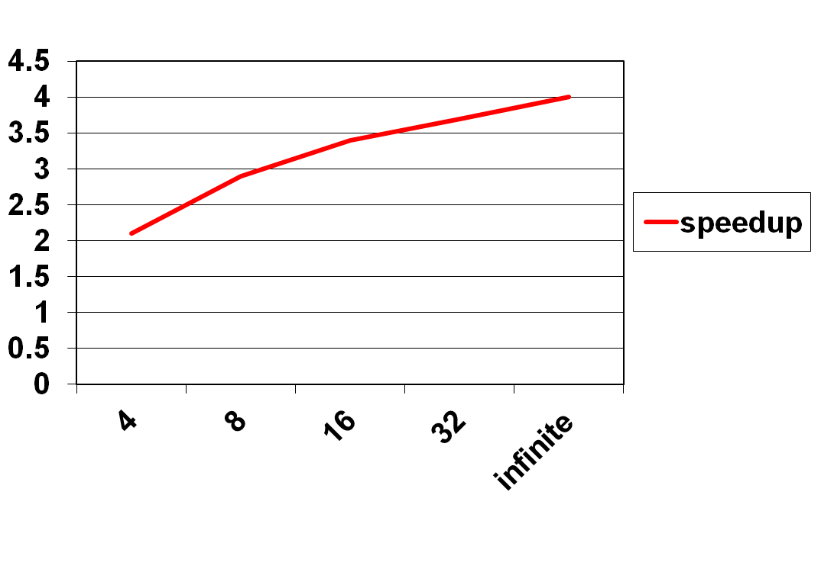
Diminishing Returns
This course is about the parts that
are hard to make concurrent …
but still have a big influence on speedup!
Notes:
With 25% sequential, cannot do more than

Slide 126
Grading
~9 Homeworks 50%
3 In-class midterms 50%
No final exam

Slide 127
Collaboration
Permitted
  talking about the homework problems with other students; using other textbooks; using the Internet.
Not Permitted
  obtaining the answer directly from anyone else in any form.

Slide 128
Crowdsourcing!
You can annotate the textbook online
  See something interesting?
  Have a question?
  Answer a question?
  Like or dislike a note?
http://nb.mit.edu
  Play the video
Details to follow …

Slide 129
Capstone
Yes, you can take this course as a capstone course
There is a fixed project
  concurrent packet filter
Requires reading ahead in the course
See web page for details

Slide 130
This work is licensed under a Creative Commons Attribution-ShareAlike 2.5 License.
You are free:
  to Share — to copy, distribute and transmit the work
  to Remix — to adapt the work
Under the following conditions:
  Attribution. You must attribute the work to “The Art of Multiprocessor Programming” (but not in any way that suggests that the authors endorse you or your use of the work).
  Share Alike. If you alter, transform, or build upon this work, you may distribute the resulting work only under the same, similar or a compatible license.
For any reuse or distribution, you must make clear to others the license terms of this work. The best way to do this is with a link to
  http://creativecommons.org/licenses/by-sa/3.0/.
Any of the above conditions can be waived if you get permission from the copyright holder.
Nothing in this license impairs or restricts the author's moral rights.
130
Notes:
130

